Slide 1
Tom Brady’s Diet for optimal performance
By Steven Capone

Slide 2
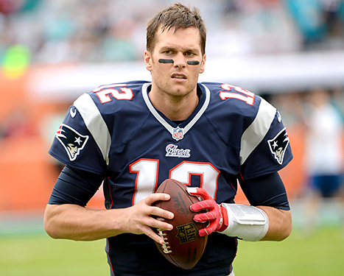
Background
❏ Grew up in San Mateo, California and was born on August 3, 1977.
❏ Graduated from the University of Michigan with a Bachelor’s Degree in General Studies.
❏ Drafted 199th Overall in the 2000 Nfl Draft by the New England Patriots.
❏ Currently married to famous supermodel Gisele Bundchen.

Slide 3

Background cont….
Brady is top 5 all time in wins, touchdown passes, passing yards, and completions among NFL quarterbacks.
Throughout his 19 year NFL career, Brady has only missed one season due to injury(Torn Acl).
A former teammate, Willie Mcginest, first introduced brady on how to properly take care of his body when he was 25 years old.

Slide 4
Purpose
❏ Brady has expressed his desire to play football into his mid 40’s and still perform at a high level.
❏ Most Nfl Quarterbacks body’s start to wear down in their late 30’s
.❏ Brady hired a personal chef, Allen Campbell, and a personal trainer, Alex Guerrero to put him through unique training and diet regimens to hopefully lengthen his career.

Slide 5
Diet and Nutrition
❏ Plant based diet, 80% of the food he consumes are vegetables while the other 20% includes lean meats such as grass-fed organic steak, duck, and chicken.
❏ Plants are rich in phytonutrients, which are key for protection against disease.
❏ Avoids anti-inflammatory foods such as Tomatoes, eggplants, peppers, and red meats.

Slide 6
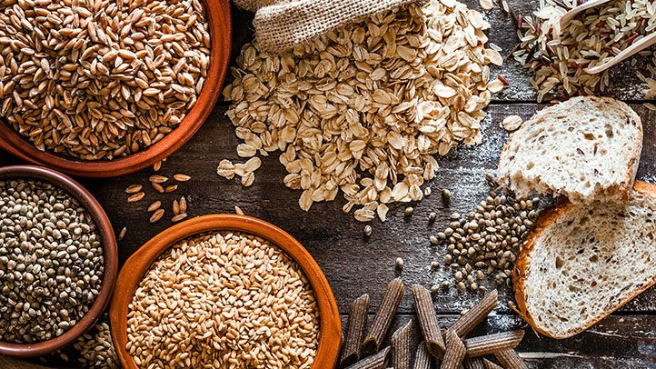
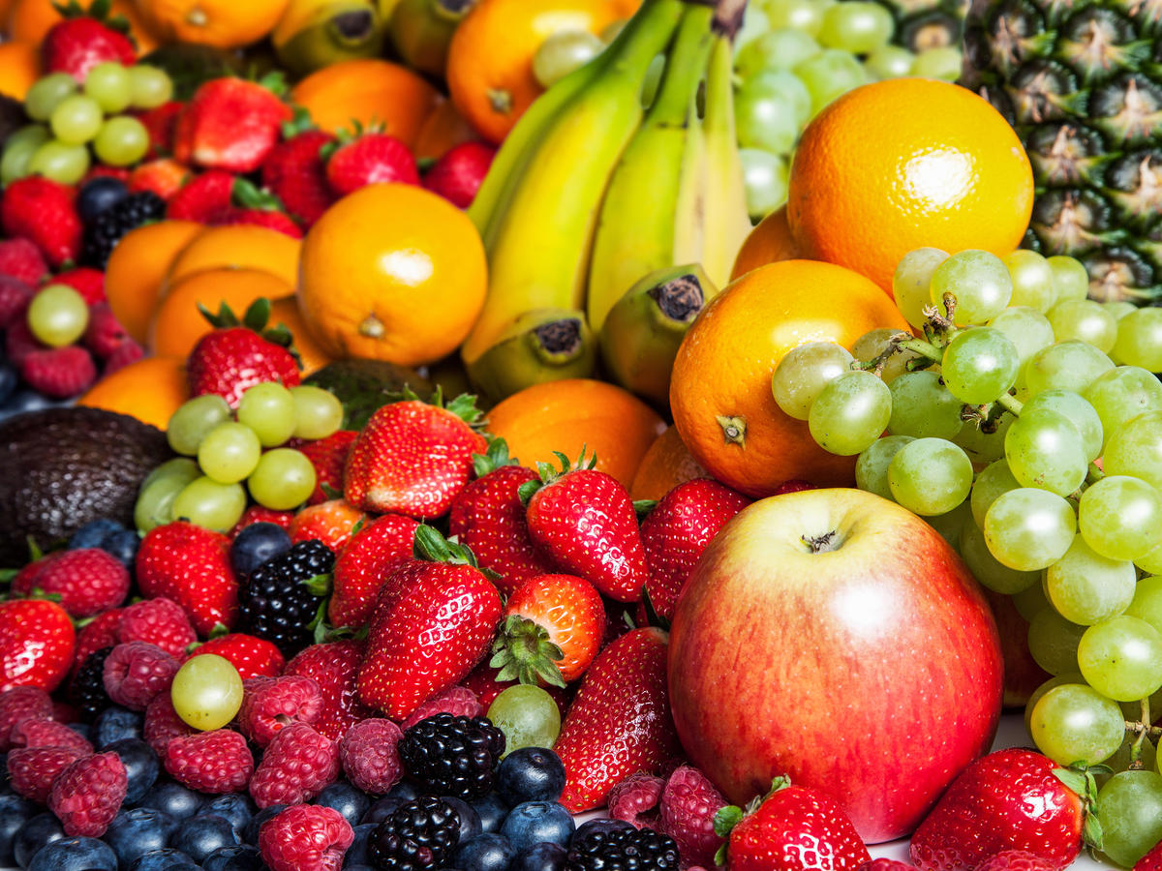
Diet continued…
❏ Sugars, margarine, fast foods, processed foods, white flour, and coffee are some of the things not included in his diet.
❏ Only eats whole grains which provides many key nutrients to help maintain optimum health.

Slide 7
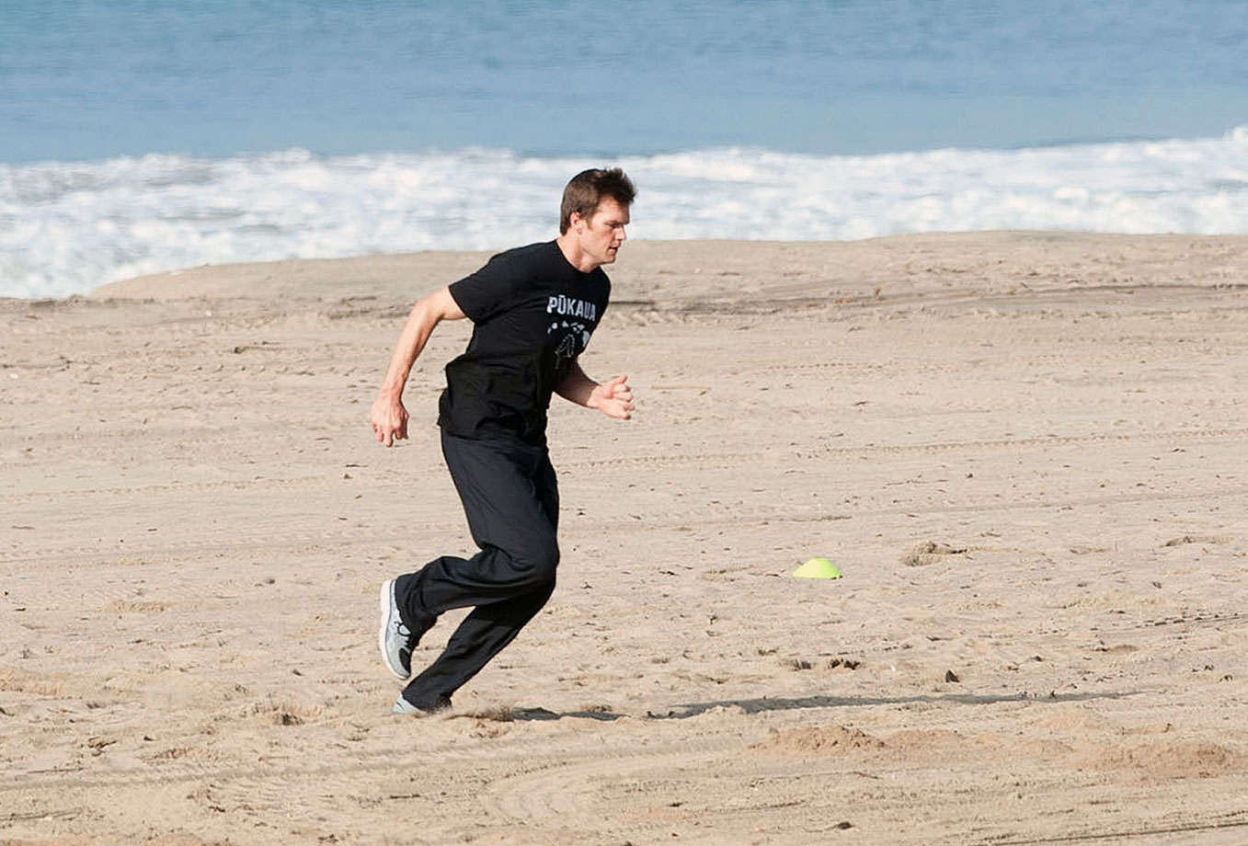
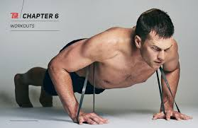
Training Habits
❏ He trains on soft surfaces such as sand and water
  This is healthier for his joints and helps prevent and rehab injuries.
❏ Rarely lifts weights, he uses resistance bands instead to train.
Pliability is his main focus, wants his muscles to function at an optimal rate when the muscles are lengthened.

Slide 8
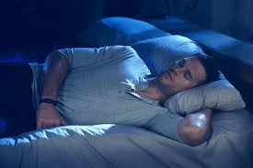
Sleeping habits
❏ Goes to sleep at 9 P.M every night to make sure his body has properly recovered, and a proper amount of sleep helps strengthen the immune system.
Sleeps in specialized TB12 pajamas that help enhance recovery during the night.
Occasionally uses a hyperbaric sleep chamber to increase the oxygen supply to his muscles.

Slide 9
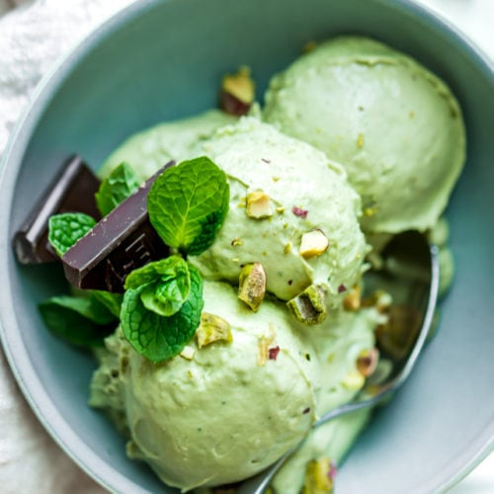
Notable foods he eats
❏ Avocado ice-cream
❏ Raw macaroons
❏ Kale for breakfast
Raw granola

Slide 10
References
❏ https://www.bostonglobe.com/sports/2014/12/12/tom-brady-metilous-he alth-regimen-revealed-article/4VpDoru88XQj7FxpKIQwIK/story.html
❏ http://www.mensjournal.com/health-fitness/nutrition/why-tom-bradys-dietworks-20160115
❏ http://www.webmd.com/diet/news/20160115/tom-brady-gisele-bundchendiet#2
❏ https://www.boston.com/sports/new-england-patriots/2016/01/04/meet-t he-chef-who-decides-what-tom-brady-eatsand-what-he-definitely-doesnt

